Slide 1
AGS
Managing Resistance to Change
(Checklist)

Slide 2
Checklist for Managing Resistance to Change
AGS
Resistance
Management
Checklist
Resistance to change is a natural part of human reaction to a change in environment.
Change managers need to be prepared to manage resistance to change to ensure their project achieves the desired results.
Tool
AGS

Slide 3
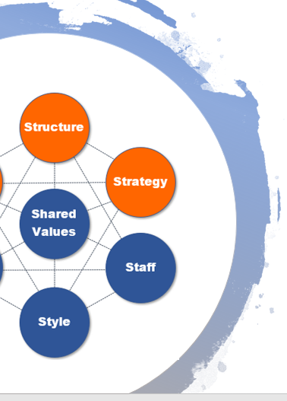
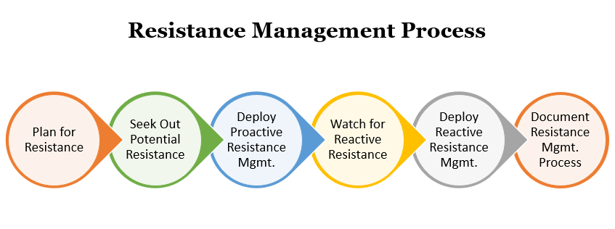
The AGS Resistance Management Checklist will take you through the 6 steps in the process of managing and overcoming resistance to change in an organization.
Resistance process overview:
Why Do People Resist Change?
Don’t understand it
Fear of change
No incentive
Distrust
Cling to habits
Bad experience
Peer pressure
Lack of knowledge
Stress

Slide 4
1. Plan for Resistance
While a world without any employee resistance to change would make change management much easier, it’s not the reality of human nature. You need to expect resistance and understand it’s a normal part of reaction to change.
You can plan for resistance by reading about resistance management to understand the reasons people resistant change at work and be prepared with strategies to overcome resistance to change when it occurs.
Resistance Planning
Learn Reasons
Study Change Resources
Review Mitigation Strategies
Use a Resistance Management Tool

Slide 5
2. Seek Out Potential Resistance
Why would you want to go looking for employee resistance? Because if you can proactively address potential sources of resistance to change up front at the beginning of a change project, it can keep resistance problems from happening and spreading to others in the same department.
When seeking out proactive resistance, you want to look at the history of a stakeholder’s change experience and at how this current change will be impacting them.
People most likely to resist would be ones that showed resistance to a past change and those who are being majorly impacted by the current change.
Find Potential Resistance
Stakeholder Assessment
Ask Supervisors
Employee Surveys
Review Workload
Impact Assessment

Slide 6
3. Deploy Proactive Resistance Management
Proactive resistance management is about trying to win over those being impacted by a change before resistance really has a chance to occur.
Proactive resistance involves active communication and education designed to allay fears, address potential resistance points, and hopefully reassure someone enough that they will not have any reasons for resistance to change.
Proactive Resistance Mgmt.
Communication
Education
Vision Sharing
Leadership Coaching
Change Agents

Slide 7
4. Watch for Reactive Resistance
While you can try to catch any potential resistance proactively, there will always be some that comes out of the blue that you weren’t aware of.
Watching for resistance throughout the change project will help you bring that resistance out in to the light where you can deal with it, rather than it staying in the shadows, possibly poisoning your project outcome.
It’s important to keep an eye out for resistance throughout the change project because the project itself may have caused reasons for resistance to change that an employee did not have at the start.
Identify Reactive Resistance
Observe Behavior
Ask Co-workers
Ask Managers
Survey Employees
Look for Non-Participants

Slide 8
5. Deploy Reactive Resistance Management
With proactive resistance management you were attempting to address a concern that might cause resistance. With reactive resistance management, you need to address a specific concern that a person or group of people already have.
You want to make sure you listen to their sources of resistance to change and don’t just assume you know what they’re going to say. Someone has to fully trust that you care about their input before they’ll listen to what you have to say.
Reactive resistance management is about validating the person’s feelings that are causing them to resist the change and then giving them the answers and reassurance that they need for overcoming resistance to change.
Reactive Resistance Mgmt.
Listen
Validate
Earn Trust
Address Concerns

Slide 9
6. Document Resistance Management Process
It’s important that you document both the reasons for resistance to change brought up by different stakeholders as well as your strategies to overcome resistance to change. This information will be invaluable to the next change management team when they’re doing their stakeholder analysis.
It’s also helpful for the organization and change management team to have so they can anticipate future resistance to change in the workplace, understand the sources of resistance to change, and the ways to overcome resistance to change that worked.
Need Help with Change Management?
It’s what we do!
Email us any time with questions at:
support@airiodion.com

