Slide 1

AGS
Role of HR in Change Management
(Checklist)

Slide 2


How HR Helps Drive Successful Change
AGS
Strategies HR Can
Use to Support
Change Management
Who is all about guiding people, understanding their concerns, and addressing their needs? The HR department.
That’s why it’s vital for any change management team to have HR on their side to help drive the change project at the ground level.
Tool
AGS

Slide 3
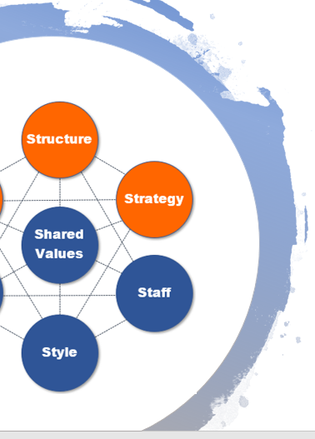

HR is the “people” part of an organization and the people are the most important piece of successful organizational change.
According to Forbes, 62% of people don’t like leaving their comfort zone. Change isn’t easy because it means a change in behavior and habits. It forces people outside their comfort zone.
HR as a change agent helps bridge the gap between the requirements of a change project and how that change is personally impacting employees.
The following is a checklist of the HR role in change management to help both HR teams and change managers understand how vital HR is in driving change.
HR & Change Management
Both share the understanding that organizations can’t change unless people change.

Slide 4

1. Provide an HR Plan for Training
The HR department may know better than a change project planning team the type of support and training employees will need to get through a change successfully.
They’ll often have insight based upon previous training and what was needed to make them successful.
The ultimate goal is to ensure people are given the chance to acquire the skills needed to successfully adopt the new processes, so having an HR change management plan for training can help ensure people are given the time needed to make that happen.
Training Considerations
Time needed
Types (online, in-person, etc.)
Proficiency testing
Different learning speeds

Slide 5

2. Act as a Key Communicator About the Change
A change project will impact the way employees do things and there may be some confusion about what’s expected during and after the change. Employees may also be fearful that if they can’t adapt, their job will be in jeopardy.
Confusion about expectations and fear of what the change means to an individual are both factors that can cause employee resistance to change.
Here, the HR role in change management can help alleviate concerns by answering questions and communicating important information about the change.
Communication
Answer questions
Explain key elements of project
Explain non-compliance actions
Provide updates
Meeting reminders

Slide 6

3. Help Change Team Anticipate Resistance
Proactive resistance management is an important part of a change project because if resistance can be anticipated, it can often be headed off and resolved before it becomes a problem.
Because of the HR department’s relationship with employees in an organization, they’ll often have insight into who may resist a particular change that the change management team may not have.
The HR change management expertise when it comes to knowing each personality type in the organization can be invaluable in identifying people that may find the change difficult and coming up with ways to mitigate that potential resistance.
Types Prone to Resistance
Routine Seeking
Emotional Reaction
Short-term Focus
Cognitive Rigidity

Slide 7

4. Watch for Resistance
The #1 reason change projects get derailed and don’t achieve their desired results is due to employee resistance to the change.
If resistance isn’t identified and resolved as soon as possible, it can poison a project and cause it to fail.
When employees are resistant to change, they may not feel comfortable bringing it up at meetings, but due to the relationship with HR, they may feel okay telling their HR director about their concerns.
The HR change management role in this case is as a watchdog for potential resistance to change.
Watching for Resistance
Survey employees
Invite 1:1 feedback
Observe behavior

Slide 8

5. Provide Resistance Mitigation Suggestions
Once resistance is identified, the change management team will work to resolve that resistance to get the individual or group from resisting to accepting and supporting the change.
They do this through direct intervention and tapping the leadership network to help. But they may not always know the best strategy to use with a particular employee.
This is where the relationship the HR team has with employees in an organization can provide invaluable.
The HR team can give insight on the best way to resolve an employee’s concerns about the change.
Resistance Mitigation:
Communicate
Educate
Listen & validate
Encourage
Engage

Slide 9

6. Suggest Opportunities for Engagement
Engaging employees in a change process can both drive support and help mitigate resistance to change.
The HR change management role in this respect is one of connecting people to potential engagement opportunities for the change project.
For example, they may know which employees are well regarded in their respective departments and who would be perfect for the Change Champions Network.
They might also be the first to spot someone feeling left out, and suggest an engagement activity.
Engagement Activities
Champions network
Milestone celebrations
Committees
Beta testing

Slide 10

7. Keep the Focus on the People
It’s easy for a change management project to get caught up in the “project” part of the change – dealing with logistics of the go-live date. But sometimes this can cause the project to lose focus on the “people” part of the change.
For example, if you spend more effort getting new software and hardware installed for the change, but less effort on training people to use those tools, the change isn’t going to go very smoothly.
The HR department can be an important catalyst to remind a change team not to lose focus on how the employees are being impacted and what needs to happen to help them adopt a new process successfully.
Need Help with Change Management?
It’s what we do!
Email us any time with questions at:
support@airiodion.com

