Slide 1

AGS
Social Impact Assessment Questionnaire

Slide 2



Questions for Social Impact Assessment (SIA)
AGS
Social Impact Analysis
Questionnaire
Social impact assessments require extensive data collection to understand all the potential positive and negative social impacts of a project or policy change.
This guide will help you identify the types of questions to ask for your public SIA surveys.
Tool
AGS

Slide 3
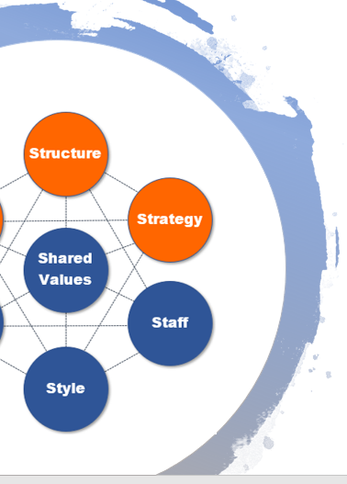






SIA Questionnaire Overview
As part of social impact assessments, questionnaires are typically sent out to various, such as local business owners, members of the public, costakeholdersmmunity leaders, and others.
A social impact assessment questionnaire will vary depending upon the project and policy change that is being made. There will be specific goals that you have for information gathering that your questions will need to reflect. Such as:
Get general population data
Understand the day-to-day activities that a project might impact
Gauge perceptions of the potential project impacts
Gather data on project awareness
Understand which impacts are viewed as more or less severe

Slide 4

Make Sure Questions are Clear
Make questions as clear as possible. For example:
NOT CLEAR: “When did you move here?”
Potential answers could be: After college, 2 years ago, 1984, etc.
CLEAR: “What year did you move to the Portland, OR area?”
This narrows down the potential answers, so everyone will provide consistent data. In this case, a year.
It’s also very important that you keep your surveys user friendly. This includes defining the project/policy that the survey refers to at the beginning.
SIA Survey Tips
Define your topic
Keep questions clear
Keep questions short
Use multiple choice to define parameters
Include open text answers to invite more input
Test your questionnaire

Slide 5

SIA Question Categories
This questionnaire is designed as a base template for you to edit for your specific project and purpose.
Because Social Impact Assessment questionnaires will differ according to the specifics of a project/policy, we’ve grouped potential questions into categories to give you guidance and ideas on how to format your project-specific questions.
Question Categories:
Baseline Activity Questions
Project/Policy Awareness Questions
Perception Questions
Social/Lifestyle Concerns Questions
Demographic Questions

Slide 6

Baseline Activity Questions
Which roads do you take for your daily commute?
How long does your commute take each day?
Do you use any outdoor recreational resources?
Which community resources do you use on a monthly basis? (multiple choice)
What are the issues in your community that you worry about the most?
What are the issues related to your way of life that you worry about the most?
Baseline activity questions help you understand the “status quo” of a community.

Slide 7

Project/Policy Awareness Questions
Are you aware of (name of project/policy)?
Did you know that there is a planned change in your community for (purpose of project/policy)?
Would you like more detailed information about activities associated with this project/policy?
Would you be interested in attending public hearings related to this project/policy?
What questions would you like to ask related to the proposed project/policy?
Project/policy awareness questions help you gauge current project awareness and interest.

Slide 8

Perception Questions
What is your perception of (name of agency or main sponsor driving the project/policy change)?
What fears do you have about new projects in your community?
What negative impacts do you fear from (name of project/policy)?
What positive impacts are you looking forward to/hoping for from (name of project/policy)?
How much do you agree or disagree with this statement: An impact in my (commute/ability to use a hiking trail, etc.) for (#) months would disrupt my life significantly. (Use a Likert Scale of intensity – strongly agree, agree, slightly agree, strongly disagree, etc. )
Perception questions give you insight into how the project/policy sponsor and impacts are being perceived.

Slide 9

Social/Lifestyle Concerns Questions
What do you value most about your community?
How is the relationship between community residents and the local government?
How worried are you about employment opportunities in your community? (Use a Likert scale)
Is there adequate healthcare availability in your community?
Have there been any environmentally-related illnesses in the area that you know of?
Would you describe your community as “inclusive?” Why or why not?
Social/lifestyle concerns questions help you understand which issues are considered the most or least important to a community.

Slide 10

Demographic Questions
What is your age?
What is your race? (multiple choice)
Are you a member of any community groups or organizations?
What neighborhood do you live in?
Do you have any children under 18?
What is your employment status? (multiple choice: full-time, self-employed, retired, etc.)
What year did you move to (name of community)?
Demographic questions help you categorize data according to individual and community characteristics.

Slide 11

Conclusion
This social impact assessment questionnaire is designed to give you ideas and get you started thinking about the scope of the questions you’ll need for your SIA.
You can find further help with social impact assessments, as well as many other types of impact assessments at Airiodion.com.
Check out our Impact Assessment Toolkit for an impact assessment template with built-in analytics that gives you a place for planning and managing your social impact assessment.
Need Help with Impact Assessments?
Contact us any time with questions at: Airiodion.com/ contact-us/

