Slide 1
Organizational
Culture Assessment Questionnaire
AGS

Slide 2
Why is Company Culture Important?
AGS
Culture Assessment
Questionnaire
The main function of culture in a company is to define organizational identity, both inside and outside the organization.
Company culture assessment helps define what a company values most, highlights its strengths and weaknesses, and assists in framing priorities and fostering a positive work environment for leadership and employees.
AGS

Slide 3
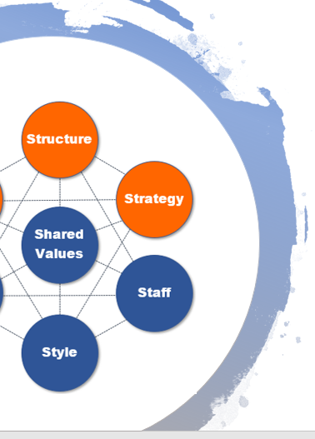
Organizational Culture Assessment Questionnaire Overview
Your feedback is greatly appreciated and will ensure that our company has a culture that reflects our values and that boosts employee fulfillment as well as organizational success.
Answers that you give will help us identify how company culture is shaping day-to-day operations, and highlight areas where improvements can be made, and successes be celebrated.
Please fill out this questionnaire as completely as possible. The goal is to understand how you experience corporate culture in your workspace, department, team, etc. We value your input.

Slide 4
1) What’s the process you’d follow if you wanted to contribute a new idea?
2) In your opinion, what is valued most in the company as a whole, and in your department specifically?
Company values most:
My Department values most:

Slide 5
3) How is success rewarded?
4) How are mistakes addressed?
5) What gives you pride about working for this company?

Slide 6
Rate the organization’s culture using the sliding scale below.
Mark an “X” in the appropriate rating where you feel the organization falls in between the two given attributes. For example, if you feel that the culture is an even mix of flexible and structured, you would choose “4.” If you feel it’s more structured, you would choose a value between 5 – 7.
6)
Flexible
1
2
3
4
5
6
7
Structured
Result Driven
1
2
3
4
5
6
7
Idea Driven
7)
8)
Chaotic
1
2
3
4
5
6
7
Stable
Competitive
1
2
3
4
5
6
7
Collaborative
9)

Slide 7
Rate the organization’s culture using the sliding scale below.
Mark an “X” in the appropriate rating where you feel the organization falls in between the two given attributes.
10)
Inclusive
1
2
3
4
5
6
7
Tribal
11)
Few Rules
1
2
3
4
5
6
7
Lots of Rules
Innovative
1
2
3
4
5
6
7
Slow to Adapt
12)
Impulsive
1
2
3
4
5
6
7
Thoughtful
13)

Slide 8
14) What are two things you would change about your daily work environment?
15) How do you describe your job to friends/family?
16) Do you feel valued and appreciated? Why or why not?

Slide 9
17) What do you feel the organization’s mission is?
18) If you could change the organization’s mission, what would you change it to?
19) Describe how often you feel stressed at work and what is causing that stress.

Slide 10
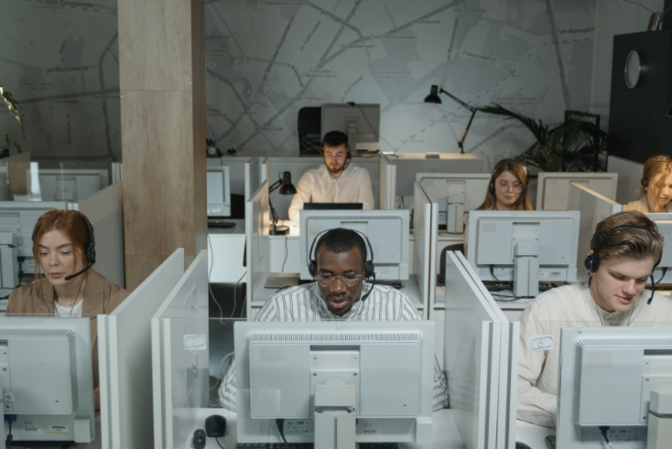
Place an “X” beneath the picture that best reflects your work environment. In some cases, neither photo may exactly match your environment, but pick the one that is the closest.
20)
A
B

Slide 11
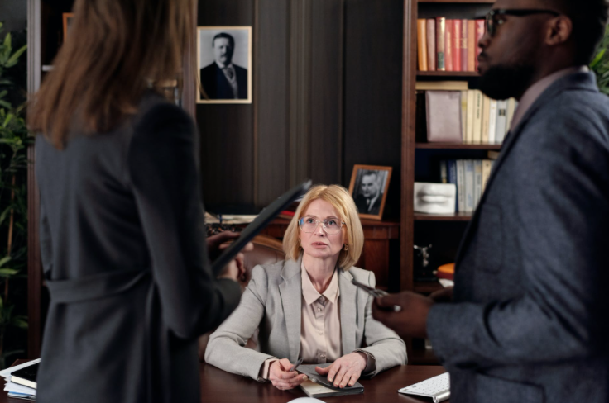
Place an “X” beneath the picture that best reflects your work environment. In some cases, neither photo may exactly match your environment, but pick the one that is the closest.
21)
A
B

Slide 12
Answer True or False to the following Questions. Circle “T” for true and “F” for false.
22) Teams have clearly defined goals that relate to the overall mission of the organization. T F
23) In our department we’re agile and sometimes “play it by ear.” T F
24) We are often asked to reach goals that are unrealistic. T F
25) If we are told about a procedure or software change, we can count on it happening according to the set timeline. T F
26) The software we use changes often, according to what leadership thinks is cool at the moment. T F
27) I feel encouraged to contribute ideas that help my organization. T F

Slide 13
Answer True or False to the following Questions. Circle “T” for true and “F” for false.
28) I feel like part of a family and our team gets along well for the most part. T F
29) Diversity is welcome at this organization. T F
30) Just when you learn something new, it changes again. T F
31) Employees are valued based upon the last profit-driven activity they accomplished. T F
32) Most of my colleagues have been with the company a long time. T F
Customers look favorably on our company and are treated well. T F
I would recommend working at this company to friends/family. T F

Slide 14
Conclusion
Thank you for your time filling out this organizational culture assessment questionnaire. Your answers will help us foster a workplace culture that makes us all proud to be a part of this team.
Image sources: https://www.pexels.com/photo/man-in-black-and-white-striped-dress-shirt-sitting-in-front-of-computer-5453824/, https://www.pexels.com/photo/group-of-people-sitting-inside-room-2422294/,, https://www.pexels.com/photo/photo-of-people-sitting-near-table-holding-papers-3184290/ , https://www.pexels.com/photo/lawyers-talking-in-an-office-4427497/, https://pixabay.com/vectors/people-human-group-person-symbol-3245739/
Questions about this Survey?
Contact us any time with questions at: Airiodion.com/ contact-us/

