Slide 1
AGS
Environmental Impact Assessment Checklist

Slide 2
Checklist for Gathering Baseline Data
AGS
Environmental Impact
Assessment Checklist
Environmental impact assessments require baseline data on multiple ecological variables so the level of impact can be measured.
This checklist will help you identify the types of information needed for your EIA.
Tool
AGS

Slide 3
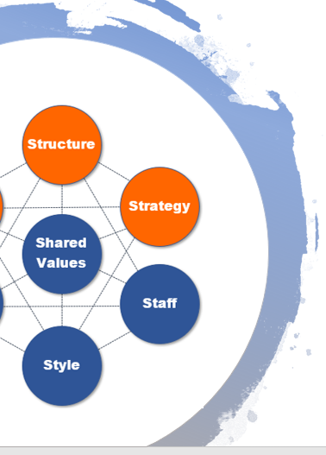
EIA Checklist Overview
The scoping in environmental impact assessment includes all impacts that a project, program, or policy change will have on the environment of a specific region or area.
To offer a reasonable estimate of the level of impact (the change from “status quo”), the baseline conditions need to be assessed and documented.
This checklist will follow the 5 key categories used for EIA reporting:
Air & Climate Ecology & Biodiversity
Land Human Environment
Water

Slide 4
Air & Climate
Describe Air & Climate:
Quantitative air quality data
Emission sources
Emission rates
Average temperatures
Average rainfall
Past natural disaster impacts
Data from climate change studies
Existing pollution vs. legal environmental standards
Susceptibility to earthquakes, landslides, erosion, wildfires or other extreme/adverse climatic conditions
Air & climate includes things like air quality, health implications, ecosystem impacts, contributions to climate change, etc.

Slide 5
Ecology & Biodiversity
Describe Vegetation:
Woodlands
Open fields
Wetlands
Genus and species of dominant vegetation
Describe Wildlife:
Terrestrial species
Aquatic vertebrates
Avian species
Describe Endangered or Threatened Species:
Endangered plants
Endangered animals
Habitat boundaries
Ecology & biodiversity includes importance of biodiversity value, both terrestrial and marine, economic use to community, ecosystem well-being, etc.

Slide 6
Human Environment
Describe Human Environment:
Noise conditions
Noise sources
Light conditions
Light sources
Employment statistics
Safety/crime statistics
Population statistics
Seasonal/tourist population statistics
Scenic areas
Recreational use areas
Main transport routes
Human environment includes things like light and noise pollution, community safety, employment opportunities, community value creation, etc.

Slide 7
Land
Describe Geology:
Geological formations
Surficial deposits
Confining layers
Describe Soils:
Soil survey information
Soil profile characteristics
Erosion details from past events
Describe Land Use:
How land is currently used
Existing manmade structures
Cultural, historical, or archaeological sites
Land includes use of non-renewable resources, changes to land morphology, impacts to historic or cultural sites, etc.

Slide 8
Water
Describe Surface Water:
Downstream receiving bodies
Water use
Stormwater runoff
Describe Subsurface Water:
Aquifers present
Depth to ground water
Water supply capabilities
Water quality
Other Water Attributes:
Identify wetlands
Identify floodplains
Water includes impacts on local drinking water, sustainability, effect of local use for irrigation and other activities, health implications, etc.

Slide 9
Conclusion
This environmental impact assessment checklist is designed to help you consider the scope of the baseline data you’ll need for an EIA.
You can find further help with environmental impact assessments, as well as many other types of impact assessments at Airiodion.com.
Check out our Impact Assessment Toolkit for an impact assessment template with built-in analytics that gives you a place for planning and managing your environmental impact assessment.
Need Help with Impact Assessments?
Contact us any time with questions at: Airiodion.com/ contact-us/

