Slide 1
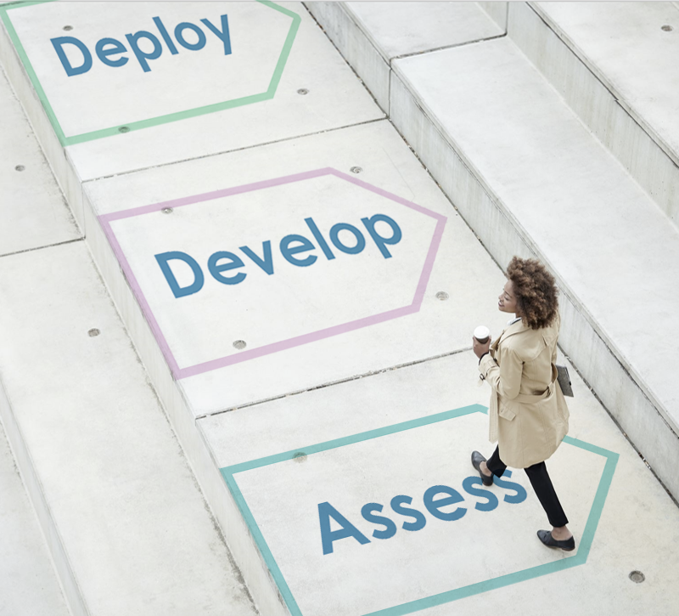
The Journey of a Change Manager & Change Team
©2021 Airiodion Global Services (AGS), Airiodion.com

Slide 2
AGS Change Management Framework
The AGS Change Management Framework is 5-phase change model that uses a "manage by deliverables" approach. The phases categorize the project actions that need to happen to conduct a successful change project from start to finish.
Each phase includes people-focused deliverables which require a set of tasks to achieve. Our change approach allows the freedom to accomplish those deliverables in the way the change team feels is most optimized. It’s also easily scalable to any size or scope of project and can be used with both Agile and Waterfall approaches.
In general, any type of change management methodology should be considered the “science” of change management. It is the same concept involved with getting an education or getting trained on something. You learn the science (method) of that topic.
Over time, you will need to build the “art” of change management, which involves developing proficiency. With years of experience, which includes seeing what works and what doesn’t work, you can build upon any change methodology, and perfect your art of change management implementation.
The AGS Change Management Framework comes from that ideal combination of the Science and the Art of change management.

Slide 3
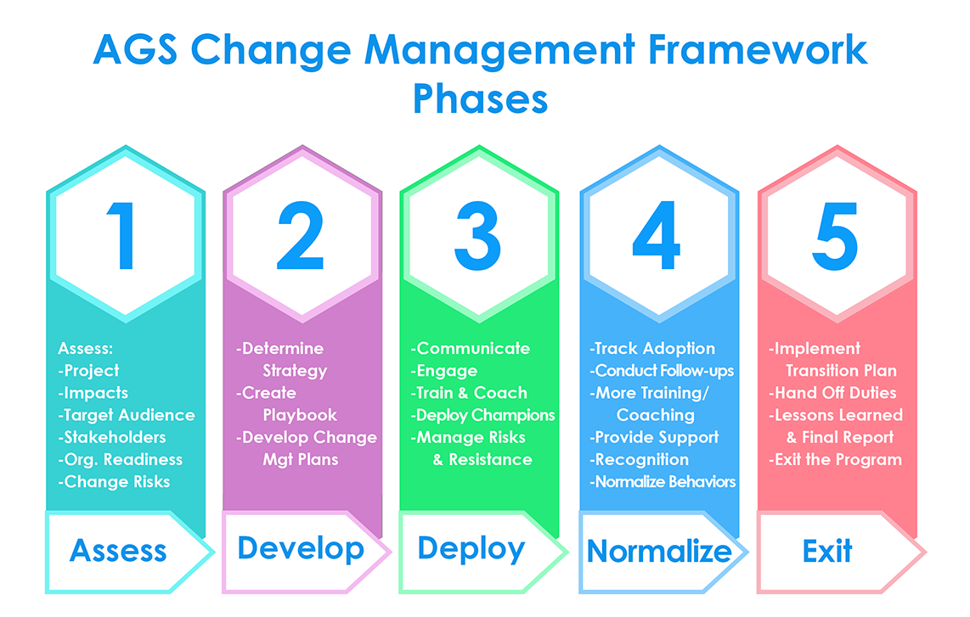
AGS Change Management Framework
This Journey of a Change Manager & Change Team takes you through the basics of the phases and deliverables of a change management project.
These of course will vary according to each project and the order you accomplish each one may change depending upon your project needs.
But having this initial workflow will give you the foundation you need for a successful change management implementation.

Slide 4
Phase 1: Assess
What you will need to do in Phase 1 of your change management, and the deliverables that will help you accomplish that.
You’ll need to learn about the project.
PROJECT ASSESSMENT
You’ll need to know which groups this change impacts.
CHANGE IMPACT ASSESSMENT
You’ll need to identify individuals & groups impacted by the change project (internal & external).
TARGET AUDIENCE ASSESSMENT
You’ll need to identify & assess key individuals that represent impacted groups.
STAKEHOLDER ASSESSMENT
Read More
Read More
Read More
Read More
You’ll need to see how ready the organization is for the change.
READINESS ASSESSMENT
You’ll need to identify where risks to the project exist.
RISK ASSESSMENT
You’ll need to proactively identify where resistance may come from.
RESISTANCE ASSESSMENT
If this change involves corporate culture, you’ll need to see where the organization’s culture is now.
CULTURE ASSESSMENT
Read More
Read More
Read More
Read More

Slide 5
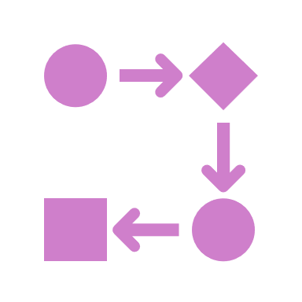
Phase 2: Develop
What you will need to do in Phase 2 of your change management, and the deliverables that will help you accomplish that.
You’ll need a change management approach & tools/software to use.
CHANGE APPROACH & TOOLS
You’ll need to decide who is responsible for each part of the change plan.
TEAM ROLES & RESPONSIBILITES
You’ll need to map out how to accomplish the mission for this change project.
CHANGE MANAGEMENT STRATEGIC PLAYBOOK
You’ll need to communicate an overview & timeline in a comprehensive way.
CHANGE MANAGEMENT ROADMAP
Read More
Read More
Read More
Read More
You’ll need to create a step-by-step plan to enable project success.
CHANGE MANAGEMENT PLAN
You’ll need to plan your approach to stakeholder engagement.
STAKEHOLDER ENGAGEMENT PLAN & ASSETS
You’ll need to plan your approach to target audience engagement.
TARGET AUDIENCE ENGAGEMENT & ASSETS
You’ll need to plan your communications with all target audiences.
COMMUNICATION PLAN & ASSETS
Read More
Read More
Read More
Read More

Slide 6
Phase 2: Develop
What you will need to do in Phase 2 of your change management, and the deliverables that will help you accomplish that.
You’ll need to decide what & who need to be trained and create topics & assets.
TRAINING PLAN, TRAINING CURRICULUM & ASSETS
You’ll need to plan how you will mitigate resistance.
RESISTANCE MANAGEMENT PLAN & ASSETS
You’ll need to plan how you engage and train leadership.
SPONSORSHIP / LEADERSHIP ENAGEMENT PLAN & ASSETS
You’ll need to identify managers that need coaching & plan for that.
COACHING PLAN & ASSETS
Read More
Read More
Read More
Read More
You’ll need to plan the deployment of a network of change champions.
CHANGE CHAMPIONS / AGENTS PLAN & ASSETS
Once the project is successfully completed, you’ll need to plan how to transfer ownership.
CHANGE TEAM TRANSITION PLAN
Read More
Read More

Slide 7
Phase 3: Deploy
What you will need to do in Phase 3 of your change management, and the deliverables that will help you accomplish that.
You’ll need to communicate with your audiences about the project.
DEPLOY COMMUNICATIONS PLAN
You’ll need to ensure sponsors & leaders are onboard & supportive.
ENABLE SPONSORS/LEADERS
You’ll need to coach managers on their role in the change project.
PROVIDE COACHING
You’ll need to deploy & manage the Change Champions/Agents Network.
MANAGE CHANGE CHAMPIONS/AGENTS
Read More
Read More
Read More
Read More
You’ll need to engage with Stakeholders.
STAKEHOLDER ENGAGEMENT
You’ll need engage with Target Audiences.
TARGET AUDIENCE ENGAGEMENT
You’ll need to trial your training program to make sure it’s effective.
DEPLOY TRAINING PILOT
You’ll need to train users on the new process/information.
CONDUCT TRAINING
Read More
Read More
Read More
Read More

Slide 8
Phase 3: Deploy
What you will need to do in Phase 3 of your change management, and the deliverables that will help you accomplish that.
You’ll need to resolve resistance proactively & reactively.
MITIGATE RESISTANCE
You’ll need to regularly measure organizational readiness for the change.
MEASURE ORG. READINESS
You’ll need to provide your final readiness report prior to “Go-Live.”
READNESS STATUS REPORT
Read More
Read More
Read More

Slide 9
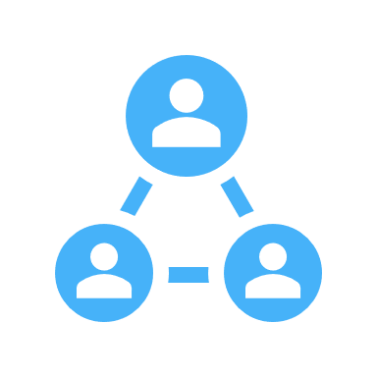
Phase 4: Normalize
What you will need to do in Phase 4 of your change management, and the deliverables that will help you accomplish that.
You’ll need to track your adoption & success metrics in all areas of the implementation.
TRACK & MEASURE ADOPTION SUCCESS
You’ll need to provide several types of support to help users after the project is live.
POST-GO-LIVE REINFORCEMENT
You’ll need to provide additional training & coaching as needed to support user adoption.
ADDITIONAL COACHING & TRAINING
Read More
Read More
Read More
You’ll need to update or create documentation for the new change or assist those responsible for updates.
CREATE/UPDATE DOCUMENTATION
You’ll need to create and submit a final adoption assessment report.
ADOPTION ASSESSMENT REPORT
You’ll need to recognize achievements (large & small) and reward change success contributors.
AWARDS & RECOGNITION
Read More
Read More
Read More

Slide 10
Phase 5: Exit
What you will need to do in Phase 5 of your change management, and the deliverables that will help you accomplish that.
You’ll need to hand off responsibility of the changed process to a permanent team & dismantle temporary assets.
EXECUTE TRANSFER / EXIT PLAN
(HAND OFF)
You’ll need to provide your final report on the change project implementation success.
FINAL CHANGE PROJECT REPORT
You’ll need to identify lessons learned, including positive and negative, to inform future projects.
PROJECT POST-MORTEM (LESSONS LEARNED)
Read More
Read More
Read More

Slide 11
Learn More About the AGS Change Management Framework
Are you interested in learning more about the AGS Change Management Framework and becoming certified in this change approach?
LEARN MORE

