Slide 1
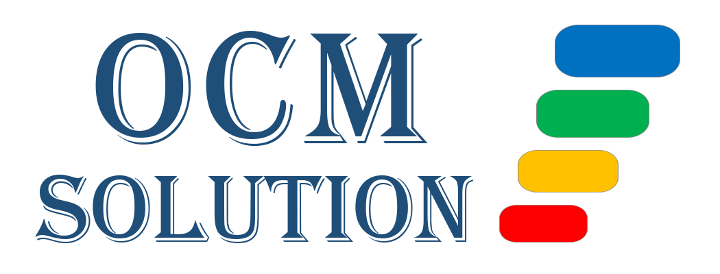
A Complete Change Management Workflow
©2022 OCM Solution
ocmsolution.com

Slide 2
OCM Solution Change Management Framework
The OCM Solution Change Management Framework is 5-phase change model that uses a "manage by deliverables" approach. The phases categorize the project actions that are needed to conduct a successful change project from start to finish.
Each phase includes people-focused deliverables which require a set of tasks to achieve. Our change approach allows the freedom to accomplish those deliverables in the way the change team feels is most optimized. It’s also easily scalable to any size or scope of project and can be used with both Agile and Waterfall approaches.

Slide 3
OCM Solution Change Management Framework
In general, any type of change management methodology should be considered the “science” of change management. It is the same concept involved with getting an education or getting trained on something. You learn the science (method) of that topic.
Over time, you will need to build the “art” of change management, which involves developing proficiency. With years of experience, which includes seeing what works and what doesn’t work, you can build upon any change methodology, and perfect your art of change management implementation.
The OCM Solution Change Management Framework comes from that ideal combination of the Science and the Art of change management.

Slide 4
OCM Solution Change Management Framework
This Complete Change Management Workflow takes you through the basics of the phases and deliverables of a typical change management project.
This workflow gives you the foundation you need for a successful change management implementation.

Slide 5
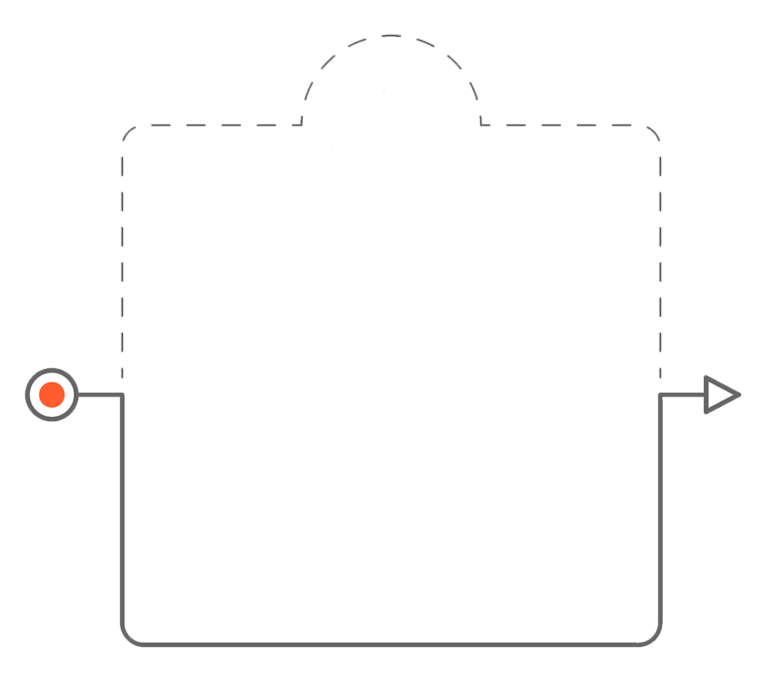
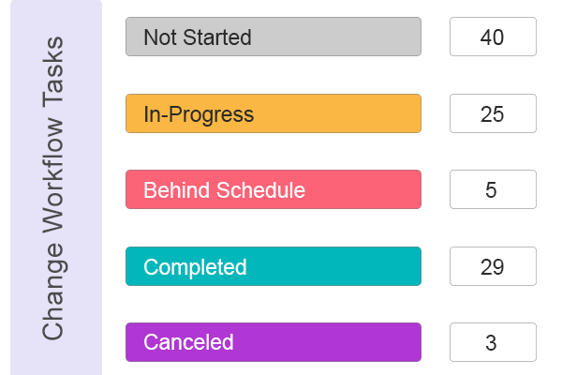
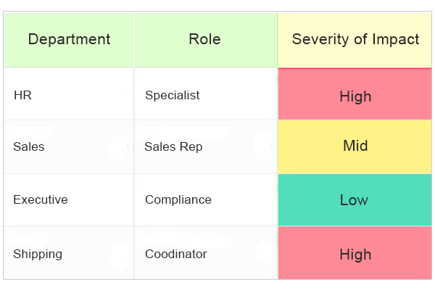
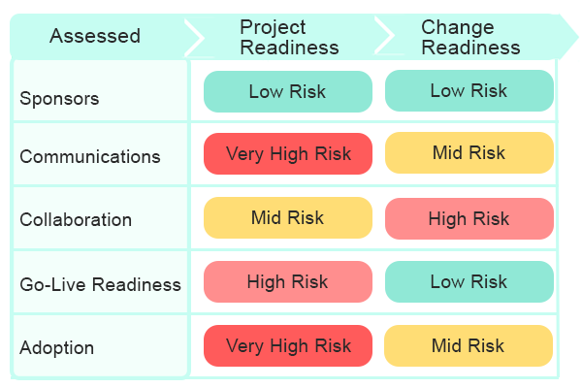
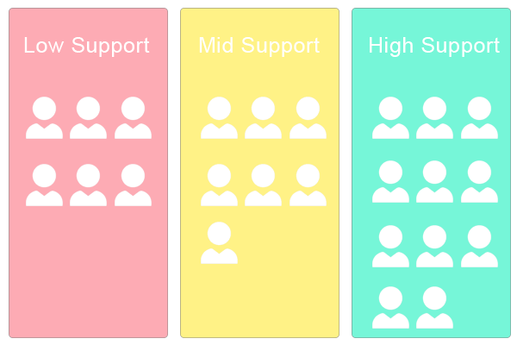
Phase 1: Assess
Conduct Change Assessments
1.1
1.3
Ramp up on Your Change Tasks
Assess Impacts
1.2
1.4
Assess Project Risk & Successes
Assess Stakeholders
Change Management Plan Template
Change Impact
Management Toolkit
Read More
Read More
Project Assessment & Risk Tracking Toolkit
Stakeholder Management Toolkit
Read More
Read More

Slide 6
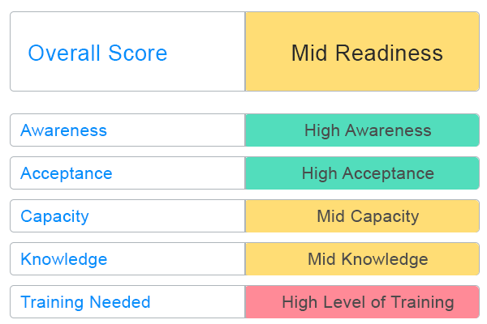
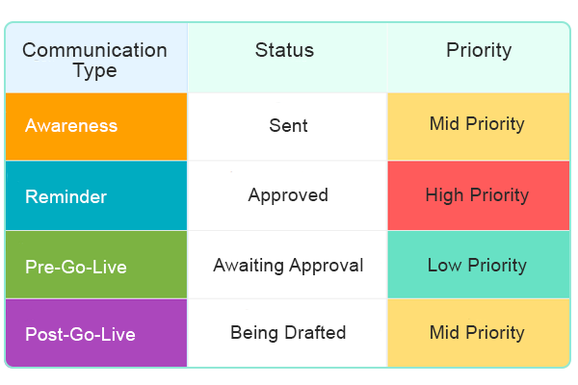
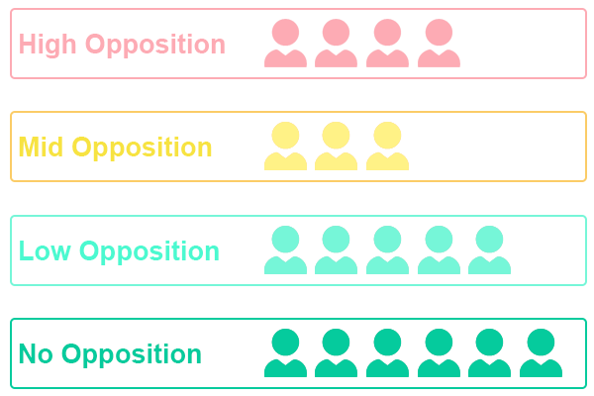
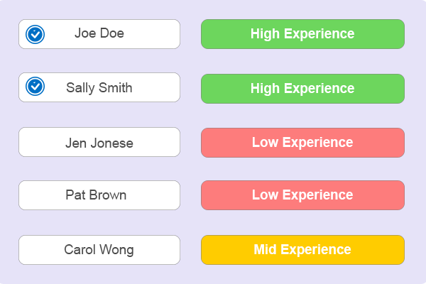
Phase 1: Assess
Conduct Change Assessments
1.5
1.7
Assess Change Readiness
Assess Communication Needs
1.6
1.8
Assess Resistance to Change
Assess Change Champion Network
Change Readiness Toolkit
Communications Management Toolkit
Read More
Read More
Resistance Management Toolkit
Change Champions & Agents Management Toolkit
Read More
Read More

Slide 7
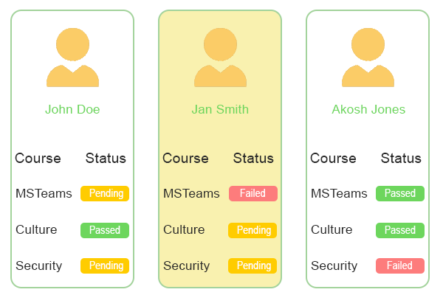
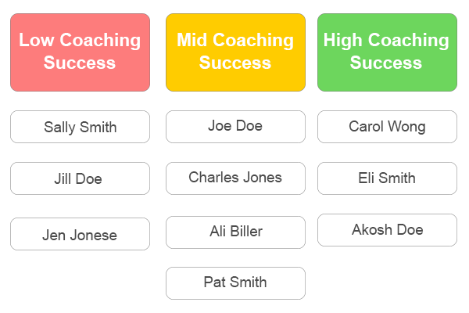
Phase 1: Assess
Conduct Change Assessments
1.9
Assess Training Needs
1.10
Assess Coaching Needs
Training Management Toolkit
Read More
Coaching Management Toolkit
Read More

Slide 8
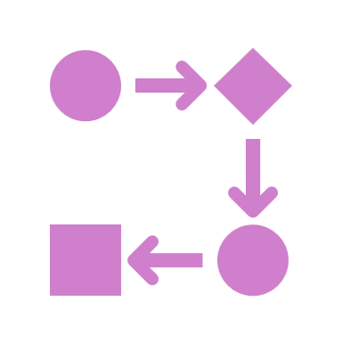
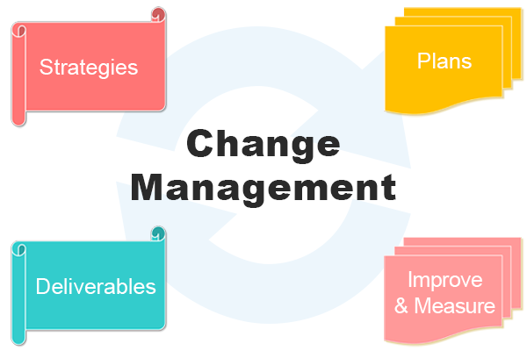
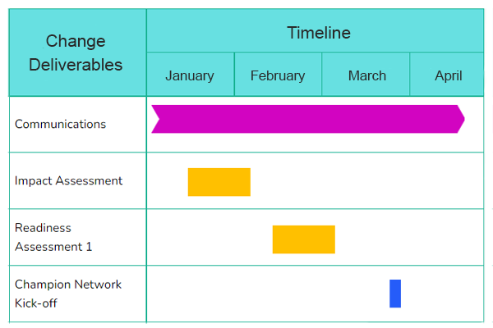
Phase 2: Develop
Create Change Strategies & Plans
2.1
2.3
Create Strategic Change Playbook
Develop Change Management Plan
2.2
Create Roadmaps
Change Management
Strategic Playbook
Change Management Plan Template
Read More
Read More
Change Management Roadmaps Tool
Read More

Slide 9
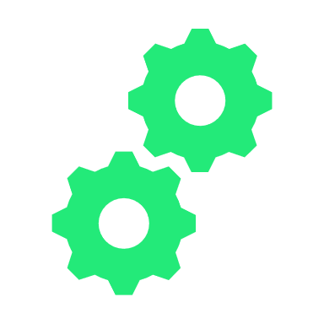
Phase 3: Deploy
Implement Change Plans
3.1
3.3
Deliver Communications
Manage Champion Network
3.2
3.4
Engage Stakeholders
Manage Resistance to Change
Communications Management Toolkit
Change Champions & Agents Management Toolkit
Read More
Read More
Stakeholder Management Toolkit
Resistance Management Toolkit
Read More
Read More

Slide 10
Phase 3: Deploy
Implement Change Plans
3.5
3.7
Deliver Training
Track Change Readiness
3.6
3.8
Deliver Coaching
Track Project Risk & Successes
Training Management Toolkit
Change Readiness Toolkit
Read More
Read More
Coaching Management Toolkit
Project Assessment & Risk Tracking Toolkit
Read More
Read More

Slide 11
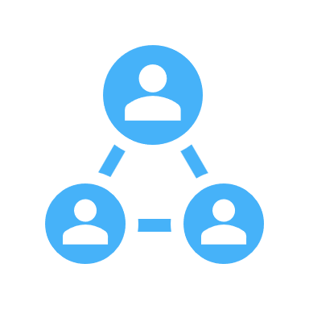
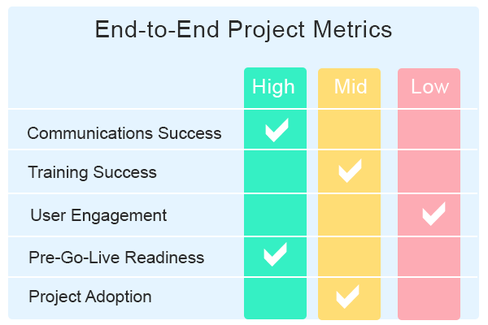
Phase 4: Normalize
Track Change Adoption Successes
4.1
4.2
Track Change Mgt. Successes & KPIs
Provide Reinforcement, Training, Rewards
Change Metrics & KPI
Tracking Toolkit
Change Management Plan Template
Read More
Read More

Slide 12
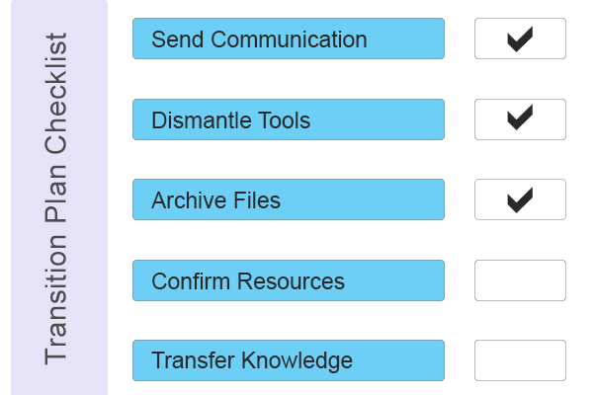
Phase 5: Exit
Change Management Exit
5.1
5.2
Implement Transition Plan
Complete Change Exit Tasks & Final Report
Transition Plan & Guide
Change Management Plan Template
Read More
Read More

Slide 13
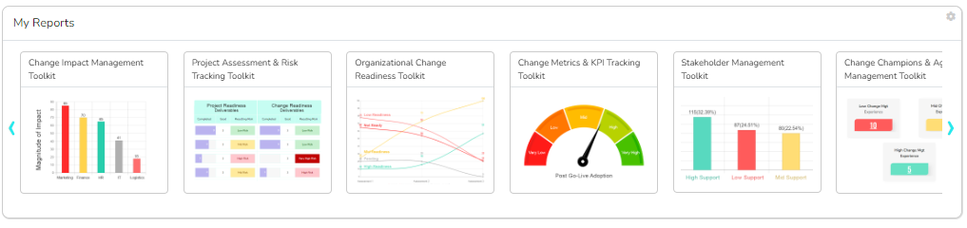
OCM Solution Change Management Software

Slide 14
Learn More About the OCM Solution Change Management Framework
Are you interested in learning more about the OCM Solution Change Management All-in-One software?
LEARN MORE

