Slide 1
AGS
Getting Started in the OCM Solution Software

Slide 2
Account Setup Checklist – First Steps
1. Name your project.
2. Ensure you have the toolkits you want added to that project.
3. Add users to your team & project.
4. Name the organizational columns to match your hierarchy.
5. Add/import your master list of organizational levels & job roles.
6. In a toolkit (e.g., the first you plan to use), customize template.
7. Customize templates for other toolkits in your project.

Slide 3
1. Name Your Project
On your Main Dashboard, scroll down to the area that says, “Which Projects Have Which Toolkits?” Click the name “1st Project.”
Click the pencil next to the default project name. Edit it, and then click “Save.”

Slide 4
2. Ensure You Have the Toolkits You Want
All your toolkits are added to your project automatically. To remove one, click “Want to Remove a Toolkit?”
Click the “X” next to any you want to remove. Then click “Click to Exit Edit Mode.”

Slide 5
3. Add Users to Your Team & Project
Scroll down the Project Home Page until you see “Add/Edit Your Project Team” Add your team members.

Slide 6
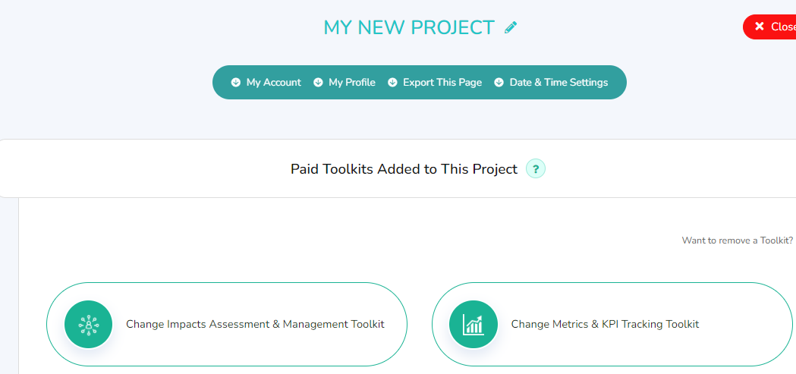
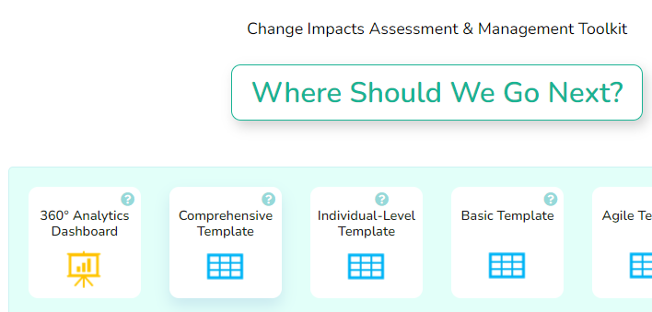
4.1 Name the Organizational Columns
From your project home page, click one of your toolkits.
Click the first Template (some toolkits have one, some have more than one)

Slide 7
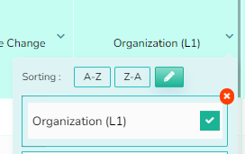
4.2 Name the Organizational Columns
Look for the columns that say:
Organization (L1), (L2), (L3), and Job Role/Title
Click the pencil & edit the name.
Click the green checkmark.
Repeat for each you want to rename.
Click the “v”
This will change these column names everywhere in your account (all toolkits).

Slide 8
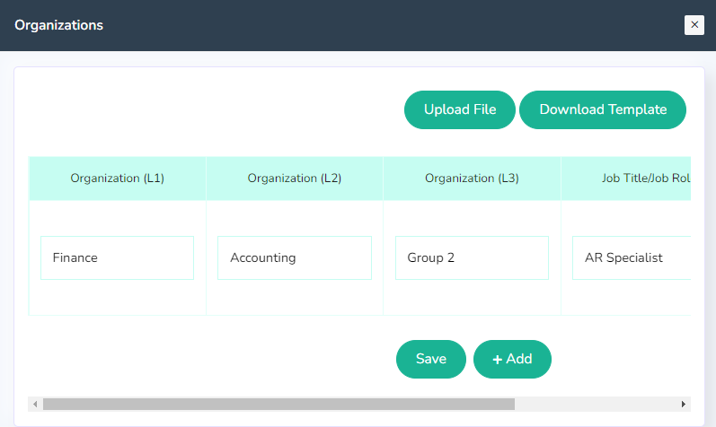
5. Add/Import Your Organization’s Lists
Click Edit/Enter Dropdown List above any of the organizational columns.
Edit or import your list of organizational groups and job roles. These will populate the dropdowns for these columns in all toolkit templates in this project.

Slide 9
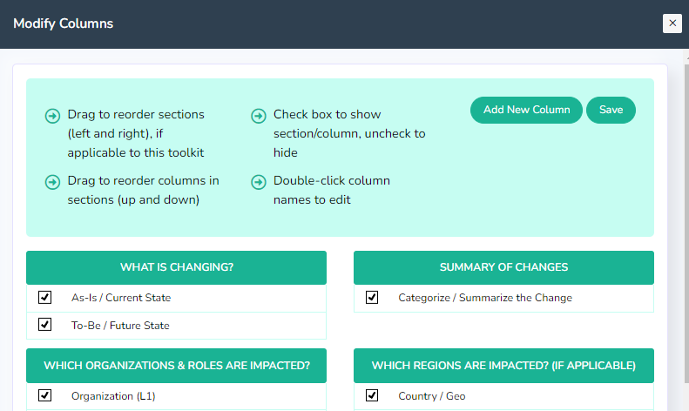
6. Customize Your Template
In your template (start with the first toolkit you plan to use), click “Modify Columns” in the submenu to customize.
Customizing includes changing other columns names, hiding columns, adding columns, moving columns.
Tip 1: Review the Sample analytics to see which columns are used on your reports.
Tip 2: Decide on customizations as a team that will work for all projects.

Slide 10
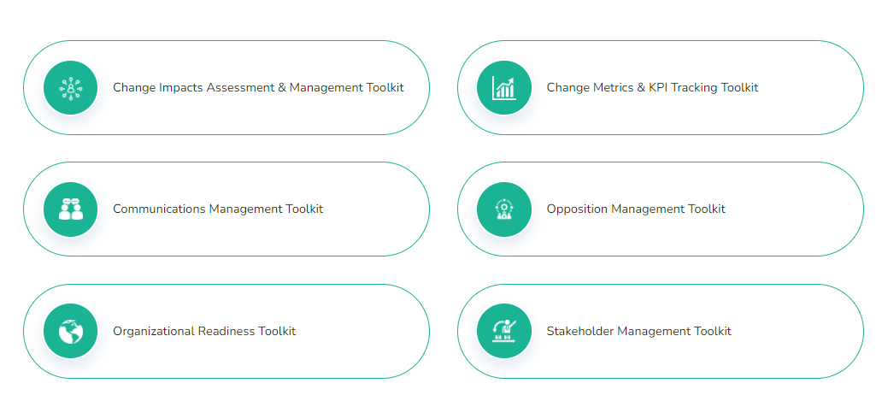
7. Customize Templates for Other Toolkits
Get your project ready for input by doing the same types of customizations in the other toolkits in your project.
You will have fewer columns to rename, because column name changes are reflected everywhere in your account.

Slide 11
AGS
Help & Support
Join a Weekly Webinar
OCMSolution.com/request-a-zoom-call/
Contact Us by Email
OCMSolution.com/contact-us/
FAQ Page
OCMSolution.com/customer-faqs/
Video Tutorials
Accounts.ocmsolution.com/content/product-tutorials/

